Slide 1
RELATIVE SPEED

Slide 2
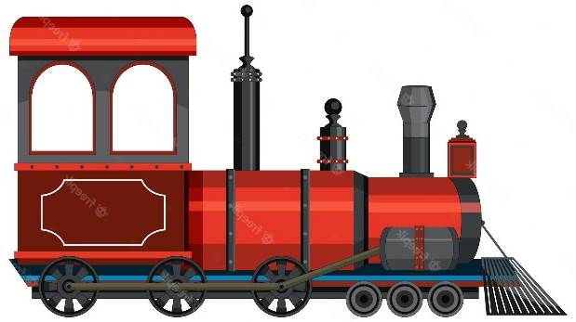
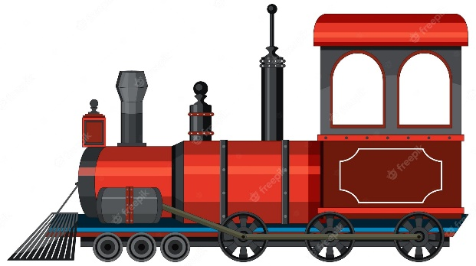
RELATIVE SPEED
S₁ S₂
RELATIVE SPEED
S_{R} = S₁ + S₂
(CROSSING)
S₁
S₁
RELATIVE SPEED
S_{R} = S₁ – S₂
S₂

Slide 3
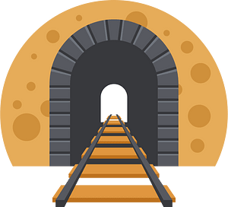
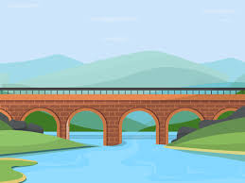
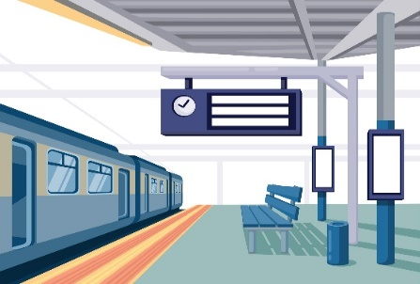
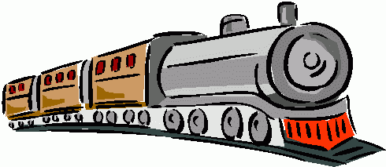

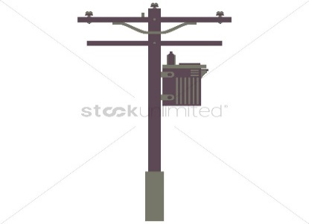
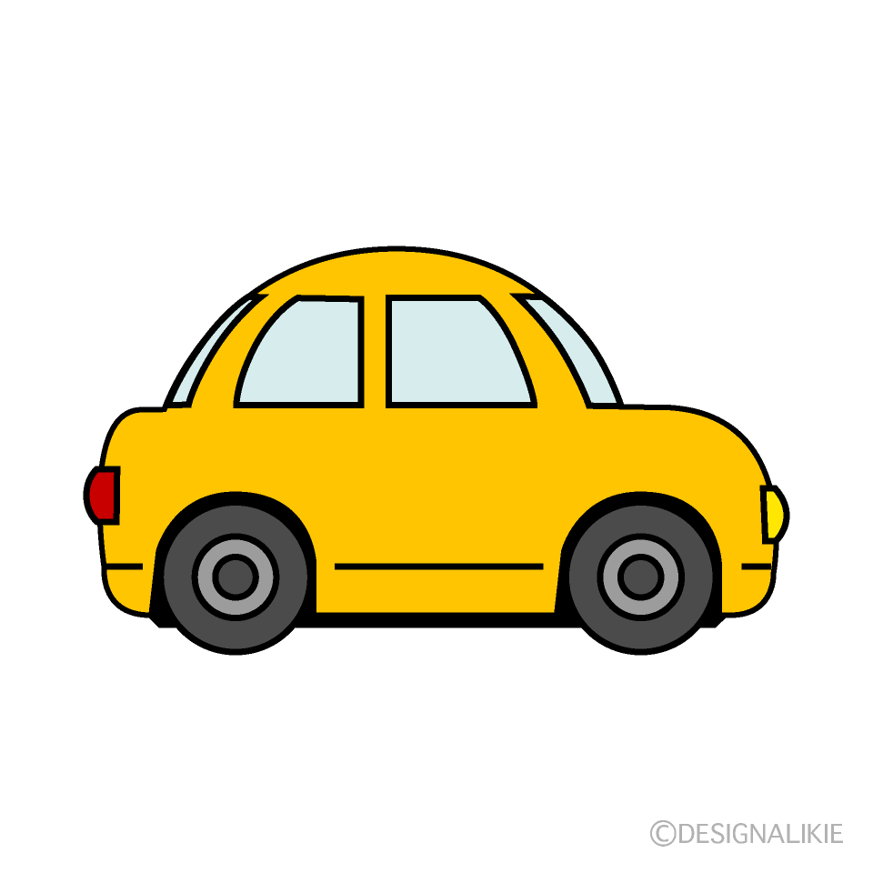
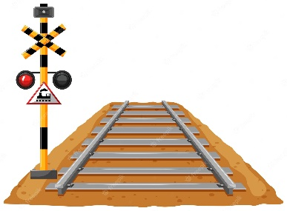
Point Object and Length Object
Length object:
Train Tunnel Bridge Platform
Point object:
Traffic signal Man Electric Pole Car

Slide 4
TRAIN PROBLEMS
Train problems broadly centre around the following three types.
L_{t}= Length of the train
S = Speed of the train
T = Time taken
1. Length object crossing the point object
Distance Travelled = Length of the train
Time taken(T) = L_{t} / S
2. Length object crossing the length object
Distance Travelled = Length of train + length of object
Time Taken = (L_{t} + SL )/ S
3. Length object crossing movable length object
Distance Travelled = Length of train + length of object Speed by which trains are moving = Relative Speed(S_{R})
Time Taken = (L_{t1} + L_{t2} )/S_{R}

Slide 5
1. A train takes 10 seconds to cross a man standing on a platform and 44 seconds to cross the platform. What is the length of the platform if the speed of the train is 72 km/h?
440 m
570 m
680 m
None of these

Slide 6
2. A train travelling at 36 km/h takes 48 seconds to cross a bridge. It then crosses a man cycling at the rate of 9 km/h in the same direction in 20 seconds. Find the length of the bridge.
150 m
220 m
280 m
330 m

Slide 7
3. Train P has a length of 300 m and a speed of 72 kmph. Train Q has a length of 600 m and a speed of 90 kmph. Both enter a tunnel in opposite directions simultaneously. The length of the tunnel is 600 m.
Which train exits the tunnel first? What length of the other train is still in the tunnel at that time (in m)?
P, 75
Q, 75
P, 90
Q, 90 3
Find the distance between the point where the rear ends of the trains cross each other and the point of entry of the slower train (in m).

Slide 8
4. Two men start travelling in the opposite direction up to a point where the other started. If they take 13 minutes and 52 minutes respectively to reach the other end, after how much time (all in minutes) would they have met?
39
10.4
26
Cannot say

Slide 9
5. A train travelling at 42 km/h passes a runner in 9 seconds running in same direction and took 5 seconds in the opposite direction. Find the length of the train.
75 m
100 m
84 m
90 m

Slide 10
6. A train travelling at 72 kmph starts overtaking a motorcyclist travelling at 36 kmph at 4 pm and overtakes him in 20 seconds. Then the train travels for exactly half an hour and starts crossing another motorcyclist travelling at 36 kmph in the opposite direction. When will the second motorcyclist meet the first motorcyclist?
4.45 pm
5.00 pm
5.15 pm
None of these

Slide 11
7. A man standing on a railway platform notices that a train going in one direction takes 10 seconds to pass him and other train of the same length takes 15 seconds to pass him. Find the time taken by the two trains to cross each other when they are running in the opposite direction (all in seconds).
12
14
13.5
15

Slide 12
8. Two guns were fired from the same place at an interval of 13 minutes but a person in a train approaching the place hears the second report 12 minutes 30 seconds after the first. Find the speed of the train in m/s, supposing that sound travels 330 metres per second?
12 m/s
13 m/s
14 m/s
13.2 m/s

Slide 13
9. A man travels from A to B at a speed of x km/h. Then he rests at B for x hours. He then travels from B to C at a speed of 2x km/h and rests for 2x hrs. He moves further to D at a speed twice as that between B and C. He then reaches D in 16 hours. If distance A to B, B to C and C to D are equal to 12 km each, the time taken for which he rested at B could be (all in hours)
3
4
5
6

Slide 14
10. A car travelling in fog passed a man walking at 3 km/h in the same direction. He could see the car for 4 minutes and up to a distance of 100 m. What is the speed of the car (all in km/h)?
40.5
4.5
1.5
5.5

Slide 15
11. Two trains of length 115 m and 110 m respectively run on parallel rails. When running in the same direction, the faster train passes the slower one in 25 seconds, but when they are running in opposite directions with the same speeds as earlier, they pass each other in 5 seconds. Find the speed of the faster train.
27 m/s
18 m/s
36 m/s
None of these

Slide 16
12. Two men left simultaneously two places A and B. One of them left A for B and the other B for A. Both travelled each with his own uniform velocity. Having arrived at their destinations, they turned back without stopping and turned back to their starting points. First time, they met on their onward journey 18 km from B; the second time on their return journey 9 km from A. Find the distance between A and B.
(a) 30 km
(b) 45 km
(c) 60 km
(d) Cannot be determined

Slide 17
13. A car travels a total distance of 150 km. After travelling a part of the distance without any trouble, the car develops an engine problem and proceeds at 2/3rd of its former speed and arrives at the destination 48 min late. Had the problem developed 24 km further on, the car would have arrived 12 min sooner. Find the original distance it travelled without any problem and the speed over that part of the journey.
(a) 100 km, 60 kmph
(b) 48 km, 36 kmph
(c) 72 km, 50 kmph
(d) 54 km, 60 kmph

Slide 18
14. Two stations X and Y are 330 km apart. Train A starts from X at 9.00 am at 60 kmph towards Y. Train B starts from Y at 10.00 am at 40 kmph towards X. At a station 120 km from Y and 210 km from X, A halts for 35 minutes. B does not halt anywhere along its journey. Find the time when both trains meet for the first time.
12.00 pm
(b) 12.30 pm
(c) 1.00 pm
(d) 1.30 pm

Slide 19
15. Two persons A and B are running around a circular track of length 1800 m at speeds of 40 m/minute and 50 m/minute respectively. Both of them start at the same point in the same direction but B reverses his direction every time he completes one round. After how much time will they meet for the first time?
180 minutes
40 minutes
80 minutes
90 minutes

Slide 20
